Slide 1

Content Marketing 101
Create content like a pro
By Zach Scamehorn

Slide 2


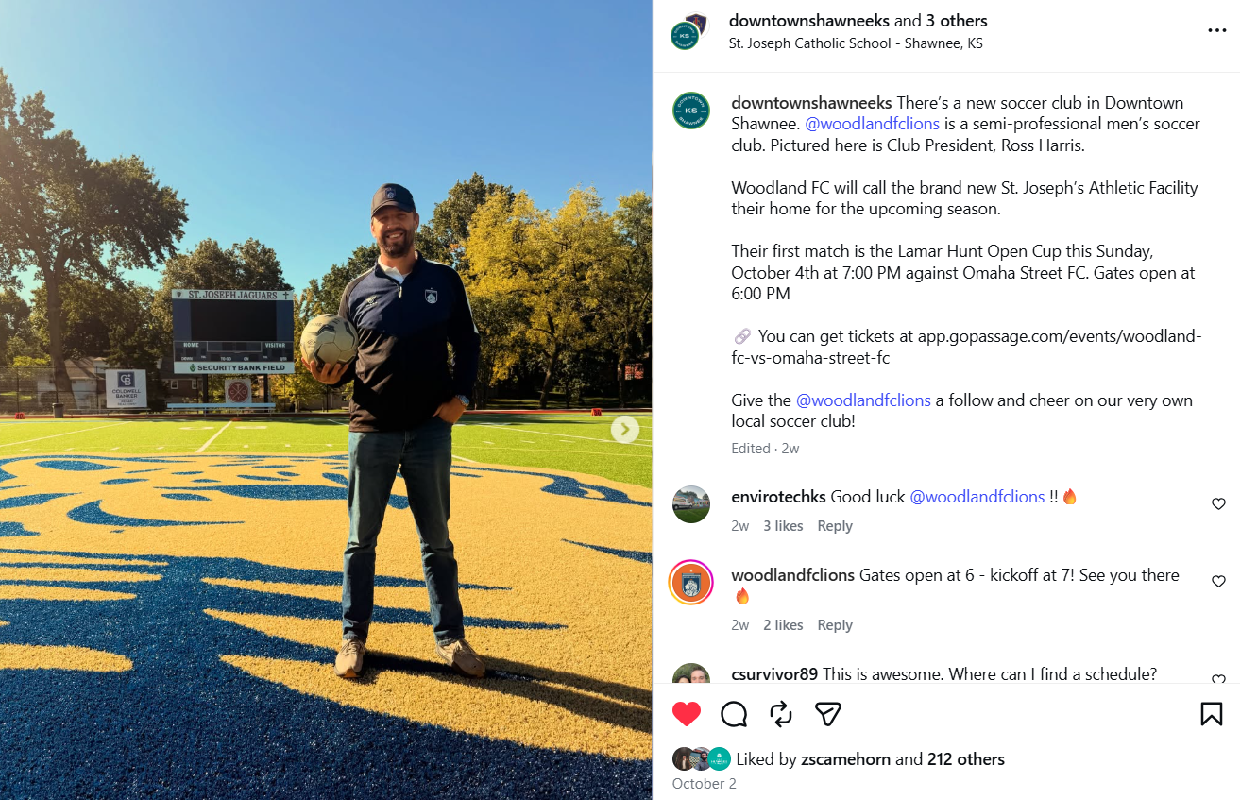
Focus on human creativity
Do
Use authentic, personal content
(real photos, videos, etc)
Do Not
Use AI slop

Slide 3
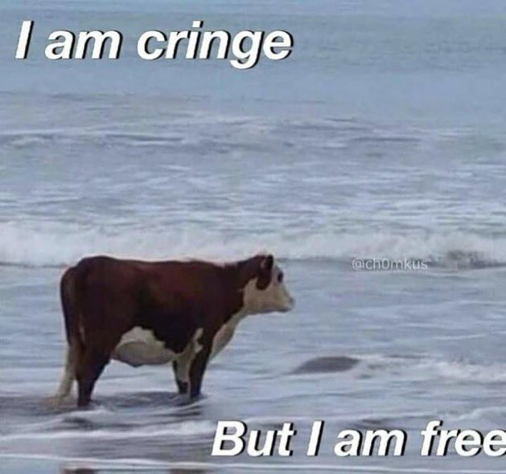
It’s ok to be cringe!
Everyone dislikes these things about themselves
Look
Sound
Mannerisms, etc
The more times you step in front of a camera, the more comfortable and confident you’ll be, AND the better your content will look.

Slide 4
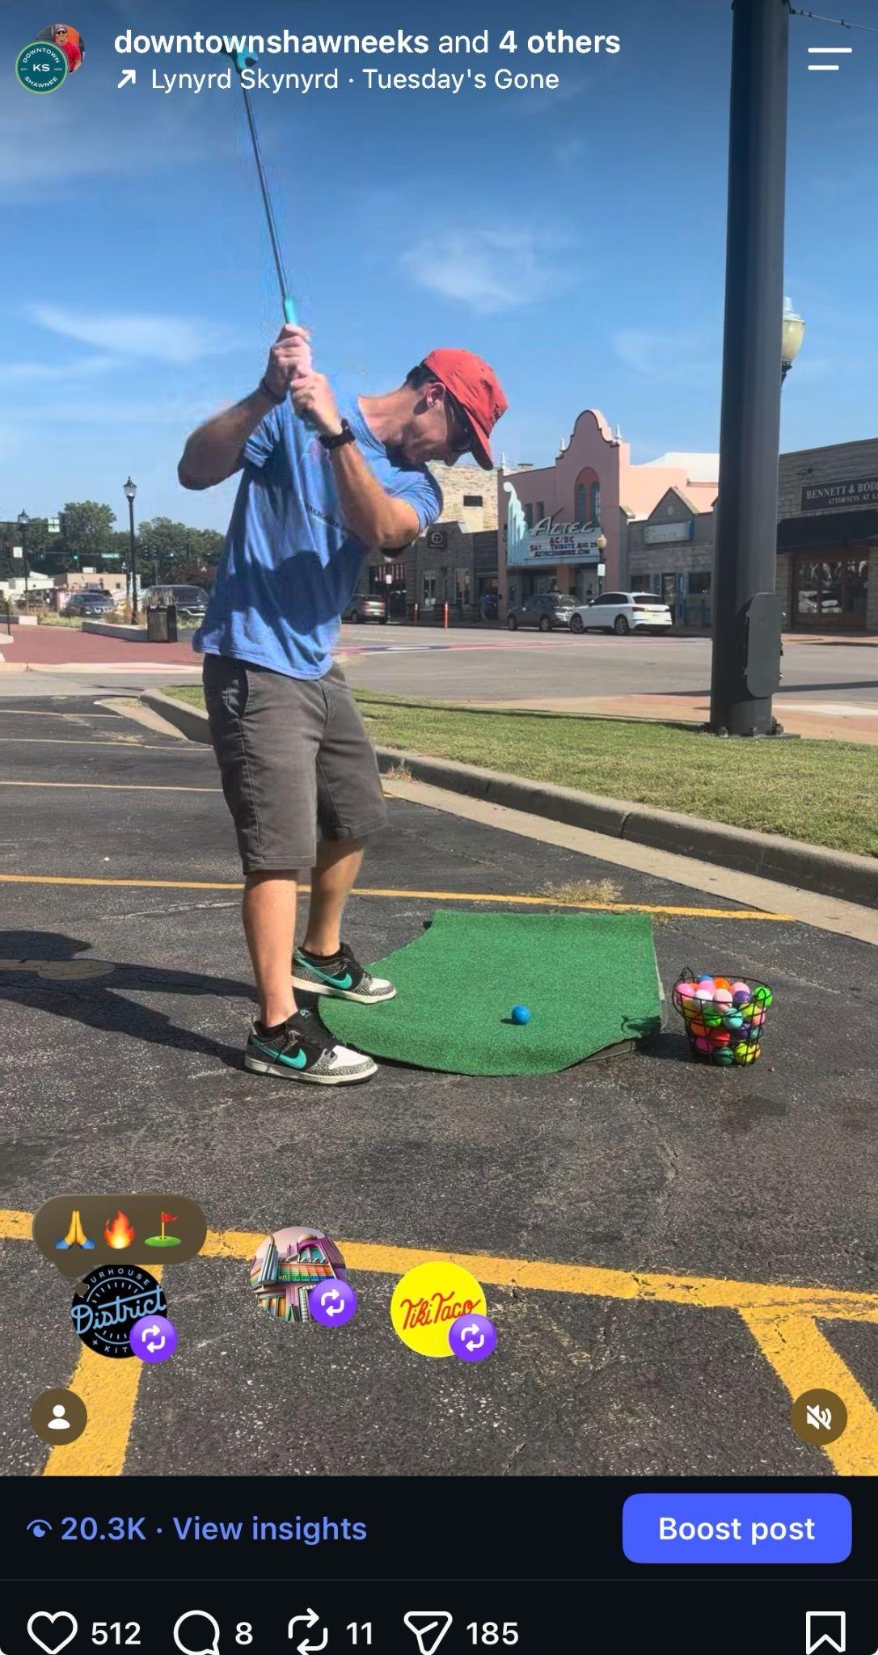
Partner with other businesses/creators and use the features available on each platform
Tools to use to make your content stand out
Location
Audio/Music
Collaboration requests

Slide 5
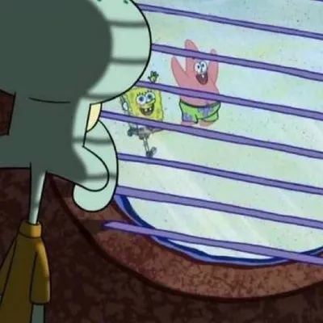
Cadence
Post often
2-7 times per week
Feed the algorithm what it wants and stay in front of your audience's eyes
Create FOMO

